Slide 1
Innovative Solutions for Solopreneurs & SMB’s
Enhance Your Business Operations, Networking, and Event Management
Vikas Chavan, Sales Intern at Mendios Technologies
Date : 25 Aug 2024

Slide 2

Welcome & thank you for joining us today.
I am Vikas S. Chavan, from Shahada (Maharashtra). Currently pursuing my graduation at SSBT’s COET, Jalgaon. Mendios Technologies is a California-based IT services company with a development center in Bangalore, India. Founded in 2011, Mendios specializes in enterprise-grade technology solutions with a focus on mobility. They offer services such as mobile app development, custom software development, UX/UI design, and more. Mendios serves both SMEs and leading Fortune 2000 companies globally, providing solutions that are simple to use, cost-effective, and adaptable to future needs23. webMOBI is a self-service engagement platform that allows you to create quickly, edit, and instantly publish engaging web apps and native mobile apps that are compatible with both iOS & Android Devices.

Slide 3



Challenges Faced by Solopreneurs and SMB’s
Managing business operations efficiently.
Building and maintaining professional relationships.
Organizing and managing events effectively.

Slide 4

Our Innovative Solutions
NexaLink
NexaLink is a digital business card platform by webMOBI. It allows you to share your contact information instantly via QR codes or links, update details seamlessly, and integrate with social media. It also offers analytics, customizable designs, and robust privacy controls.
webMOBI
webMOBI is an AI-powered platform for creating mobile and web apps for events, enterprises, and universities. It provides tools for event management, enterprise solutions, and university applications, all with customizable features and AI integration.

Slide 5
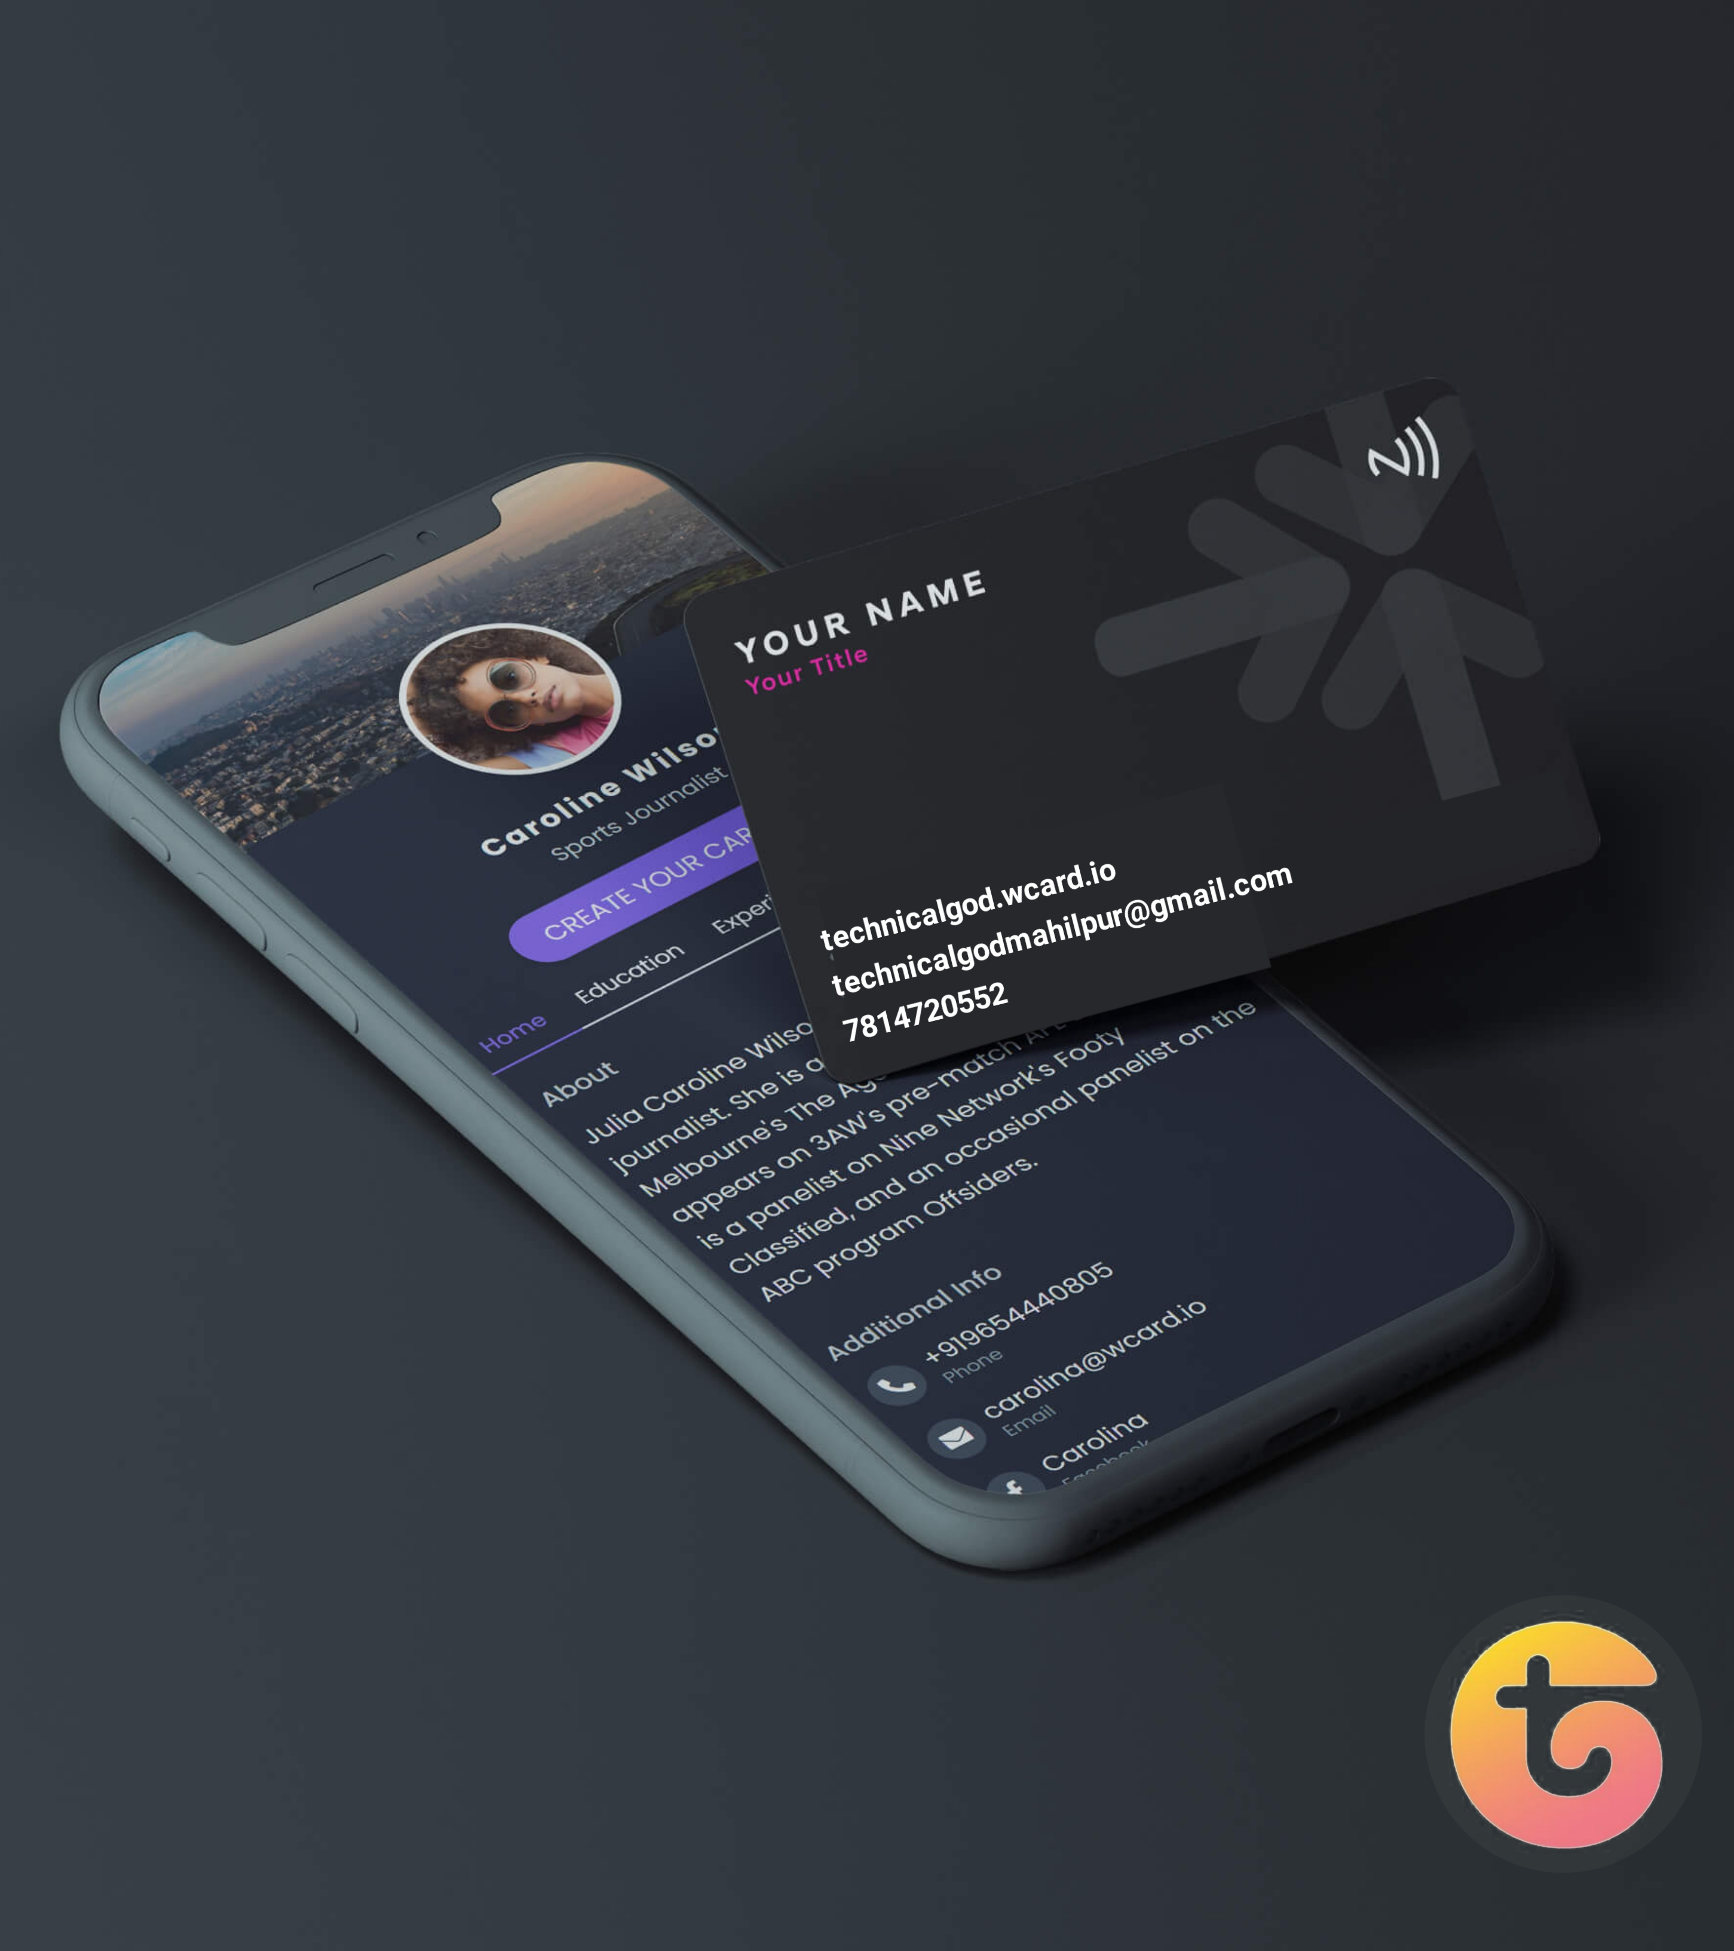
NexaLink Digital Business Cards
Convenience : Easily share contact information digitally.
Customization : Personalize your digital card.
Eco-Friendly : Reduce paper waste.

Slide 6
NexaLink Personal Relationship Management
Efficient Networking : Manage professional relationships.
Integration : Seamlessly integrate with CRM systems.
Analytics : Gain insights into networking efforts.

Slide 7
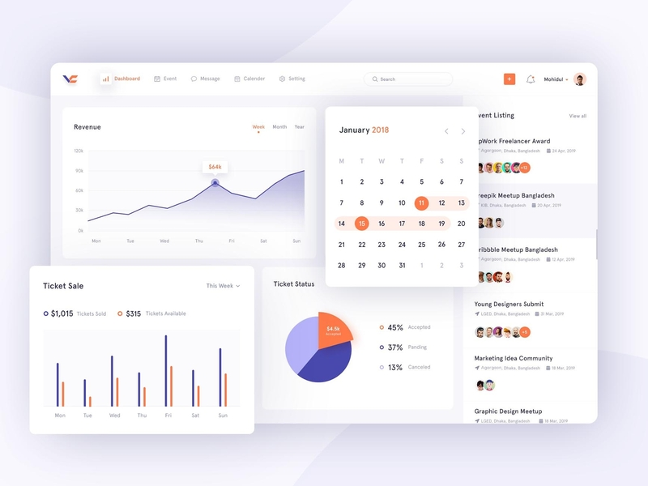
webMOBI Event Management Platform
All-in-One Solution : Manage in-person, hybrid, and virtual events.
Engagement Tools : Live polls, Q&A sessions, gamification.
Analytics and Reporting : Track event performance.

Slide 8



Benefits of Adopting Our Solutions
Enhanced Efficiency : Streamline operations.
Improved Networking : Build valuable relationships.
Effective Event Management : Host successful events.

Slide 9


Ready to Transform Your Business?
Next Steps : Schedule a demo or sign up for a free trial.
Contact Information : vikaschavhan368@gmail.com

Slide 10

Thank you
- Thank you for your time.
- We look forward to working with you.
vikaschavhan368@gmail.com

